Slide 1
Case study: 8-Queen
Computational thinking

Slide 2
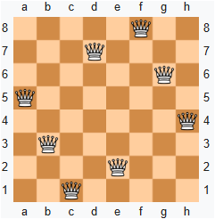
8-Queen problem
Place 8 queens on an 8 × 8 chessboard such that no two queens attack each other. A queen can attack another queen if they are placed in the same row, the same column, or on the same diagonal.

Slide 3
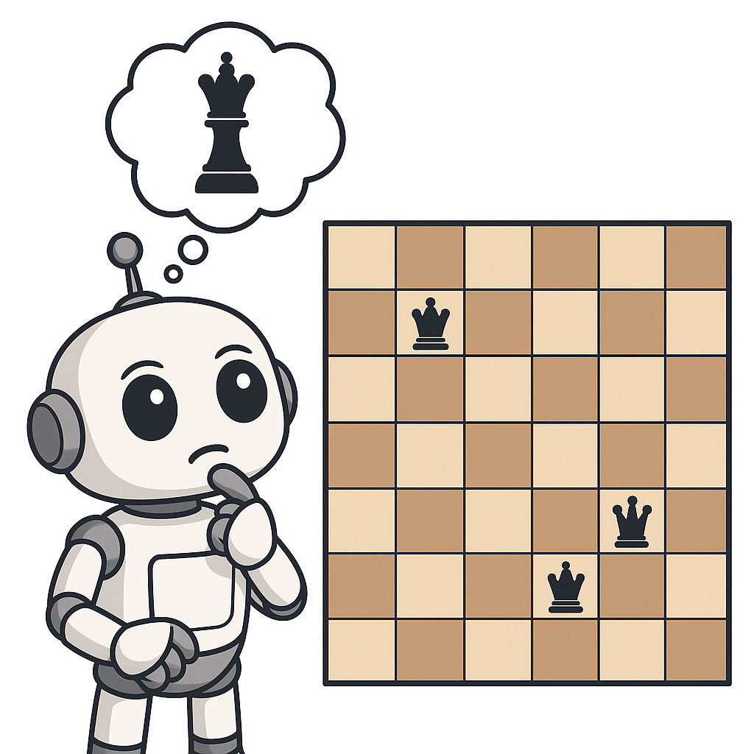
Problem analysis
Place 8 queens so they do not attack each other => ill-defined
Well-defined
Input: Empty 8×8 chessboard
Output: Valid configurations with 8 queens
Constraints: No two queens share the same row, column, or diagonal

Slide 4
Decomposition: split into subtasks
Determine where to place the first queen (row 1)
For each subsequent row, find a safe column
Detect conflicts with already placed queens
If no valid column exists, backtrack to the previous row
Repeat until all 8 queens are placed

Slide 5
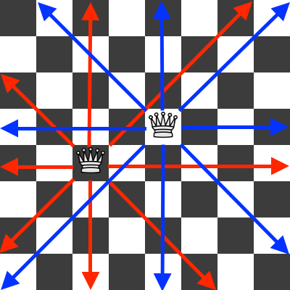
Pattern recognition
Each row has exactly one queen
Columns must be unique
Diagonal attacks:
Main diagonal → row − column = constant
Anti-diagonal → row + column = constant

Slide 6
Abstraction: Focus on what matters
Represent board as 1D array: positions[1..8]
positions[i] = j → queen in row i, column j
Ignore empty cells
Only enforce column & diagonal constraints

Slide 7
Algorithm design - Naive approach
Backtracking approach:
1. Start at row 1
2. Try each column
If safe → place queen, move to next row
If blocked → backtrack
5. Repeat until 8 queens placed

Slide 8
Pseudo code
function solve(row):
if row > 8:
printSolution()
return
for col in 1..8:
if isSafe(row, col):
positions[row] = col
solve(row + 1)
positions[row] = 0 # backtrack
function isSafe(row, col, positions):
for i in range(1, row): # check row
if positions[i] = col:
return False # same column
If |positions[i] - col| = |i - row|:
return False # both diagonals
# if positions[i] - i == col - row:
# if positions[i] + i == col + row
return True

Slide 9
Simulation: Mental Execution / Dry Run / Algorithm Testing
Purpose: logic checking before implementation
Tools
Flowchart
Sample run with small values

Slide 10
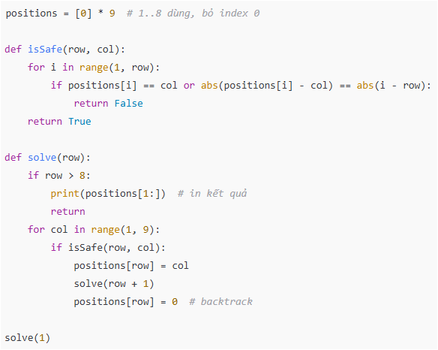
Implementation
Notes:
"""n_queens.py
Backtracking solver for the N-Queens problem.
Default N = 8. The solver can return all solutions or just one.
Each solution is represented as a list `cols` of length N where
cols[row] = column index (0-based) of the queen in that row.
"""
from typing import List, Generator
def solve_n_queens(n: int = 8) -> List[List[int]]:
"""
Return all distinct solutions for N-Queens as lists of column positions.
Example for N=4 one solution: [1, 3, 0, 2] meaning:
row0->col1, row1->col3, row2->col0, row3->col2
"""
solutions: List[List[int]] = []
cols = set() # occupied columns
diag1 = set() # occupied major diagonals (r - c)
diag2 = set() # occupied minor diagonals (r + c)
board = [-1] * n # board[row] = col
def backtrack(row: int):
if row == n:
# Found a valid placement — append a copy
solutions.append(board.copy())
return
for c in range(n):
if (c in cols) or ((row - c) in diag1) or ((row + c) in diag2):
continue
# place queen
board[row] = c
cols.add(c); diag1.add(row - c); diag2.add(row + c)
backtrack(row + 1)
# remove queen (backtrack)
cols.remove(c); diag1.remove(row - c); diag2.remove(row + c)
board[row] = -1
backtrack(0)
return solutions
def format_board(cols: List[int]) -> str:
"""
Convert a solution (cols list) into a multi-line string board with 'Q' and '.'.
"""
n = len(cols)
lines = []
for r in range(n):
row_chars = ['.'] * n
c = cols[r]
row_chars[c] = 'Q'
lines.append(' '.join(row_chars))
return '\n'.join(lines)
def print_solutions(solutions: List[List[int]], limit: int = None):
"""
Pretty-print solutions. If limit is provided, print at most `limit` solutions.
"""
total = len(solutions)
print(f"Total solutions: {total}\n")
count = 0
for sol in solutions:
count += 1
print(f"Solution #{count}: (cols = {sol})")
print(format_board(sol))
print()
if limit is not None and count >= limit:
break
if __name__ == "__main__":
N = 8
sols = solve_n_queens(N)
# Print all (for N=8 there are 92). To avoid huge output, we print first 5 then summary.
print_solutions(sols, limit=5)
if len(sols) > 5:
print(f"... (printed 5 of {len(sols)} solutions)")
# If you want just one solution:
if sols:
one = sols[0]
print("\nOne example solution (board format):")
print(format_board(one))

Slide 11
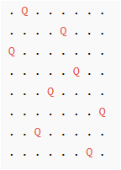
Sample output

Slide 12
Improvement
Optimizations: Bitmasks, heuristics for larger N
Notes:
https://chatgpt.com/s/t_690c2da0c2ec8191ba0a086bed03dbf3

Slide 13
Further reading
Bài toán về N-queens | OR-Tools | Google for Developers
https://github.com/NassarX/nqueens-optimization
https://www.spoj.com/problems/NQUEEN/
https://en.wikipedia.org/wiki/Eight_queens_puzzle
N-Queens - LeetCode

Slide 14
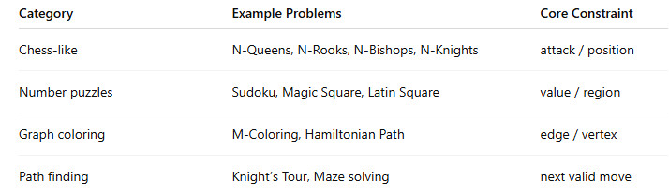
Type of the problem
Constraint-based backtracking
Place items (pieces, numbers, colors, etc.) one by one so that each placement satisfies local constraints.
If a conflict occurs → backtrack and try another option

Slide 15
Benefits of Constraint-Based Backtracking
Completeness: If a solution exists, it is guaranteed to be found
Handling Complex Constraints: highly effective
Search Space Pruning: Forward Checking / Constraint Propagation helps rapidly eliminate entire branches of infeasible searches, significantly reducing the processing time compared to a brute-force approach

Slide 16
Similar problems

Slide 17
Activity - Group 1-8
Demonstrate how you use computational thinking in solving the following similar problems

Slide 18
Similar problems (1)
1. N-Rooks Problem
Place N rooks on an N×N chessboard so that no two rooks attack each other.
Constraint: no two rooks share the same row or column
2. N-Knights Problem
Place N knights so that none of them attack each other.
Constraint: knights cannot be within an L-shaped move of each other (2 by 1).

Slide 19
Similar problems (2)
3. N-Bishops Problem
Place N bishops on the board so that no two attack each other.
Constraint: avoid placing bishops on the same diagonals only.
4. Sudoku Solver
Fill a 9×9 grid with digits 1–9 so each row, column, and 3×3 box contains all digits.
A classic constraint satisfaction problem solved by backtracking + validation.

Slide 20
Similar problems (3)
5. M-Coloring Problem (Graph Coloring)
Given a graph G and M colors, assign colors to vertices so that adjacent vertices differ.
Each vertex → choose a color → validate before moving on.
Applications: scheduling, resource allocation.
6. Hamiltonian Path / Cycle
Find a path visiting each vertex exactly once (or returning to the start).
Similar recursive structure: try next vertex, backtrack if no move is valid.

Slide 21
Similar problems (4)
7. Knight’s Tour Problem
Move a knight on a chessboard so it visits every square exactly once.
Equivalent to finding a Hamiltonian path in a 64-vertex graph
8. Magic Square
Fill an N×N grid with numbers 1..N² so that all rows, columns, and diagonals have the same sum.
Solvable via permutations + constraint pruning.

Slide 22
Similar problems (5)
9. Latin Square / KenKen / Kakuro
Variations of Sudoku with arithmetic or regional constraints.
10. 8-Puzzle / Sliding Puzzle
Not pure backtracking (usually solved with A*), but still a state-space search with constraints.

Slide 23
Applications into
Smart travel system

Slide 24
1. Personalized Itinerary Planning

Slide 25
Time Constraints
The total duration of the trip must not exceed the allowed number of days
Travel time and visit duration at each location must fall within the venue's operating hours
The schedule must avoid undesirable time slots (e.g., rush hour)

Slide 26
Budget Constraints
The total estimated cost (flights, accommodation, tickets, meals) must not exceed the set budget.

Slide 27
Preference/Priority Constraints
The itinerary must include destinations with specific interest tags (e.g., history, food, nature)
The itinerary must exclude unwanted locations (e.g., already visited, low rating)

Slide 28
Logical/Geographical Constraints
The order of destinations must ensure feasibility of travel (e.g., point A must precede point B if they are in distant cities)

Slide 29
2. Optimal Sequencing and Routing

Slide 30
Added constraints
The algorithm searches for an ordered sequence of destinations (a path) that minimizes the total cost (time, distance, money) while simultaneously satisfying all temporal, geographical, and logical constraints
It uses constraint propagation techniques combined with backtracking to quickly rule out invalid permutations of destinations (e.g., a path that requires 12 hours of travel when the user only has 8 hours available)

